Slide 1
Practice Makes Perfect Presentation

Slide 2
Create a Professional Physical Environment
See what background shows in your video camera
Ensure your background is:
Clean
Uncluttered
Neutral
Avoid:
Potentially offensive displays
Unmade beds
Dirty laundry

Slide 3
Create a Professional Online Environment
Ensure you turn off slack, email, phone notifications etc.
Your desktop background should be appropriate
Have your files ready to roll
Know your controls in advance

Slide 4
Ensure you Look Professional
Is your camera angled correctly?
Do you have enough light so that your face is showing clearly?
Are you facing your camera?
Are you wearing a professional top?

Slide 5
Body Language is Important!
Curtail swaying
Don’t flap your hands too much
Look straight at the camera
Sit up straight

Slide 6
Ensure you Sound Professional
Test your microphone beforehand to ensure sound quality
Are you talking into your camera / microphone?
Are there distracting background noises to eliminate?
Stay muted during others’ presentations

Slide 7
Practice, Practice, Practice!
If you’re comfortable public speaking: at least 2x
If you’re uncomfortable public speaking: at least 5x
Pay attention to:
Ums, Uhs, ands, you knows, so…
Pace – are you motoring through too quickly?
The more you practice, the less nervous you will be and the more confident

Slide 8
Stack your Audience
If you’re particularly nervous, invite family and friends
Give them questions you can answer comfortably

Slide 9
To get a Recording Shared…
You must practice with me
You must complete the media release form
I have ultimate say because I want your best foot forward

Slide 10
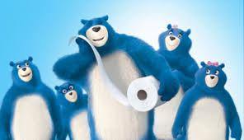
Enjoy the Go

Slide 11
Questions?

